Slide 1
SWRC TASK REQUEST SYSTEM
Aug 26, 2025
Krishan Arpidani, Harith Hamdani, Abd Hamid
Notes:
Good morning to our respected leaders and fellow team members. I am Krishan from MMP GQ OPS, and together with my team members, Harith and Abd Hamid, we will be presenting our project entitled: SWRC Task Request System.

Slide 2

Become Aware of Problem
D0
D1
D2
D3
D4
D5
D6
D7
D8
1.
Why is SWRC still relying on manual email-based requests when process involves high-volume, time-sensitive sampling and shipments?
2.
What visibility or tracking mechanisms are missing that causes critical requests to be overlooked or delayed?
Notes:
Before we begin, let’s understand the RnR of SWRC. As we know, the Special Work Request Center, or SWRC, is the central in managing lot sampling, shipment, and lots disposition execution for reliability plans. But till to this date, request being sent to SWRC still relies heavily on email communication. That creates inefficiency, errors, and delays .
This situation makes us reflect on some critical questions:
First, Why are we still relying on manual, email-based requests when the volume and urgency of these tasks are so high? – This helps us question whether the current channel is even suitable for the workload.
Second, What visibility or tracking mechanisms are missing that allow critical requests to slip through unnoticed? – If requests can be missed so easily, it means the system has no proper monitoring or escalation in place.
By asking these questions, we are not only identifying the gaps in the current process, but also preparing ourselves to evaluate the right solution

Slide 3



D0
D1
D2
D3
D4
D5
D6
D7
D8
D1: Forming the Team
Krishan Arpidani
Harith Hamdani
Abd Hamid
MMP GQ Ops Engineer
MMP GQ Ops Test Process Engineer
MMP GQ Ops Senior Technician
Notes:
Therefore, we formed a team which consists of myself, Harith and Abd Hamid to brainstorm solutions and tackle the issues.

Slide 4
D0
D1
D2
D3
D4
D5
D6
D7
D8
D2: Describing The Problem
Request via Email
⚠️ Manual
SWRC job requests are entirely email-based
No centralized tracking -> request missed/delayed
High sampling WIP with no prioritization mechanism
Manual tracking
⚠️ Error-prone
Execution
⚠️ Low visibility
Example case scenario:
QAWR 121739 and 121740 missed shipment to MSB for Thermal Warpage
Impact: Delayed by 2 weeks which caused impact to QR
Root cause: Due to high WIP sampling and missed out on email request
Notes:
Now that we are aware of the issue, let me describe the problem in more detail.
Currently, the SWRC job request process is entirely email-based. This creates inefficiencies because there is no centralized tracking system. As a result, requests can be easily missed or delayed.
On top of that, there is already a high sampling work-in-progress, and without a clear prioritization mechanism, urgent requests are not always handled first.
This has already caused real impact. For example, for QAWR 121739 and 121740, shipments for Thermal Warpage were missed, leading to delays and impacted the QR date.
When we look deeper, the root cause lies in communication gaps and the absence of a structured workflow. Without a proper system, accountability and limited visibility, this may put our operations at risk.
That is why addressing this problem is so critical before it escalates further.

Slide 5
D0
D1
D2
D3
D4
D5
D6
D7
D8
D2: Describing The Problem
Who addressed the problem?
MMP GQ OPS
Why is this a problem?
Lack of a centralized tracking system and no prioritization mechanism
What is the problem?
Request process is entirely email-based, causing missed requests, shipment delays, and poor visibility.
When was the problem occurred?
Whenever high requests especially sampling requests been sent to SWRC
Where did the problem occur?
GQ OPS Reliability Lab
How the problem occurred?
Requests arrive via email → no central log → high WIP sampling → request missed → QR or TAT impacted.
Problem Statement: Email-only process causes missed requests and delays.
Notes:
In describing the problem, let’s break it down using the 5W1H.
Who addressed the problem? It was taken up by the MMP GQ OPS team.
What is the problem? The request process is entirely email-based, which has led to missed requests, shipment delays, and poor visibility.
Where did it happen? At the GQ OPS Reliability Lab, within SWRC operations.
Why is this a problem? Because there’s no centralized tracking system and no prioritization mechanism to manage workload effectively.
When does it occur? It happens whenever there are high-volume requests, especially sampling requests sent to SWRC.
How does it occur? Requests come in through email, but without a central log, and with high WIP sampling, some requests get missed—leading to shipment delays and risks to QR and TAT compliance.
This breakdown makes it clear how the email-only process creates significant gaps in visibility and control.

Slide 6
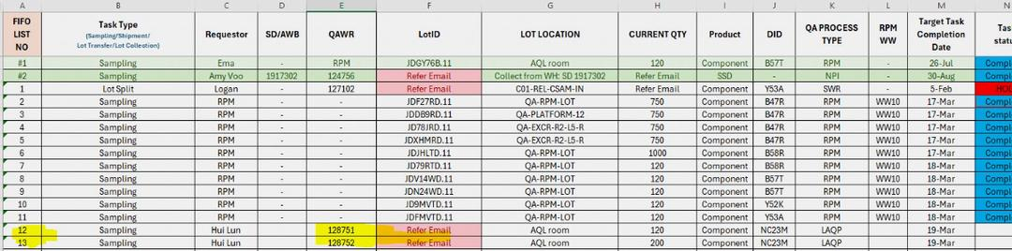
D0
D1
D2
D3
D4
D5
D6
D7
D8
D3: Implementing Interim Containment Action
Email
request
Update in Excel tracker
Arrange by priority
SWRC execute requests
Update sheet when complete
Implemented Action
Introduced Excel-based tracking system to prevent missed shipments
Planner/Engineer inputs requests from emails (sampling, lot transfer, shipment, scrap)
Requests prioritized → executed by SWRC
Completed tasks moved to ‘Completed Request’ sheet
✅ Provides better visibility & accountability
Limitations
⚠️ Relies on manual updates → prone to human error
⚠️ No real-time notifications for requestors
⚠️ Not scalable for high-volume operations
⚠️ Reinforces need for automated ticketing system
Notes:
As an interim measure, we introduced an Excel-based tracking system to prevent further missed request.
Here’s how it works: Planner or operation engineer inputs all job requests—such as sampling, lot transfer, shipment, or scrap—into a centralized Excel file based on emails received from requestors. The planner then arranges the requests in priority order, and SWRC executes tasks accordingly. Once a task is completed, it is moved to a separate sheet labeled “Completed Request.”
This approach provides better visibility and accountability compared to the previous email-only process.
However, this solution is a temporary fix and has several weaknesses: it depends heavily on manual updates, making it prone to human error; it lacks real-time notifications; and it is not scalable for high-volume operations.
These limitations reinforce the need for a robust, ticketing system to ensure long-term process reliability and efficiency.

Slide 7
D0
D1
D2
D3
D4
D5
D6
D7
D8
D4: Identifying Root Causes
CATEGORY | Suspected RC | Potential Risks | Justification
Man | Operation Competency | Low | Operators were trained and certified
Machine | Excel | Medium | Used only as a manual tracker
 | Email | Medium | Channel for requests
Material | Unstructured requests | Medium | Request emails often lack required information
Method | Manual Update | HIGH | Relies on planner or engineer to key in requests into Excel
 | Email-only requests | HIGH | Intake is unstructured and unmanaged; no central system to queue, prioritize, or escalate requests.
Measurement | No WIP/aging data | Medium | Inability to track work-in-progress or pending request aging
 | No new request trigger | Medium | No system-generated alerts for new requests
Man
Material
Measurement
No WIP/aging data
Operation Competency
Unstructured requests
No new request trigger
Missed requests → directly impacting QR date and risking TAT.
Email
Email-only requests
Excel
Manual update
Machine (Tools)
Method
Notes:
In identifying the root causes, we analyzed the problem using the 5M approach.
First, under Machine/Tools, we found that Excel and email are the only tools being used. Excel works only as a manual tracker without automation or alerts, while email is the sole channel for requests, often overloaded and fragmented, causing requests to be missed.
Next, under Method, requests come in only through email, which makes intake unstructured and unmanaged. On top of that, updates are done manually in Excel, heavily relying on planners or engineers, which is prone to human error, especially during peak workload.
For Material or Information, requests are often unstructured. Many emails lack key details such as attributes, lot IDs, or required actions, leading to confusion and slower processing.
Looking at Measurement, we found two major gaps. There is no data to monitor WIP or request aging, and there is also no automatic trigger to notify when new requests arrive. This means planners must constantly scan inboxes, increasing the chance of oversight.
Together, these weaknesses explains why the email-only process is the top pareto that leads to missed requests, shipment delays, and risks to QR date and TA.

Slide 8
D0
D1
D2
D3
D4
D5
D6
D7
D8
D4: Identifying Root Causes
Request from emails got overlooked
Why?
No central tracking system
WHY WERE REQUEST MISSED?
Why?
Request handled only via email
Why?
No standard way of sending requests
Why?
Process relies entirely on manual effort and communication
Notes:
To drill deeper into the issue, let’s analyze using the 5 Whys technique.
So first we ask, Why were requests missed? Because emails were overlooked or buried in inboxes. Why were emails overlooked? Because there was no central tracking system to consolidate and monitor all requests. Why was there no tracking system? Because requests were handled only through email, with no structured workflow. Why was the workflow unstructured? Because there was no proper SOP to manage prioritization and request sending/receiving. Why was there no SOP? Because the process relied entirely on manual effort and communication, without proper tools or governance.
From this analysis, we can conclude that the primary root cause is an email-only, unstructured request process with no centralized ownership or tracking, which makes it highly prone to missed requests and delays.

Slide 9
D0
D1
D2
D3
D4
D5
D6
D7
D8
D5: Develop Permanent Corrective Action
Option Criteria | Current Solution | Option 1 | Option 2 | Option 3
 | Excel Tracker | Enhanced Excel with Macros | Shared Email with Rules | Web-Based Ticketing System
Cost Avoidance (Efficiency / OPEX) | 3 | 3 | 3 | 5
Feasibility (Implementation achievability) | 3 | 2 | 4 | 5
Time to Implement | 5 | 4 | 4 | 3
Impact (Solution Effectiveness) | 2 | 3 | 3 | 5
Total Score | 13 | 13 | 14 | 18
5
4
3
2
1
Ideal offerings, exceeds criteria
Above-average offerings, exceed criteria
Acceptable offerings, meets criteria
Below-average offerings, fails to meet criteria
Unacceptable offerings, fails to meet criteria
Notes:
In D5, we evaluated different options for a permanent corrective action using a decision matrix.
Our current solution, the Excel tracker, scored poorly because it is manual, error-prone, and provides limited visibility. It is acceptable in cost and easy to implement, but it fails to address the root causes effectively.
Alternative 1 was an enhanced Excel tracker with macros. While it adds some automation, it still relies heavily on manual updates and therefore carries the same weaknesses as the current solution.
Alternative 2 was a shared mailbox with rules. This option is feasible and improves email organization, but it does not provide prioritization, dashboards, or real-time visibility.
Finally, our chosen solution is the web-based ticketing system. It scored the highest overall. This system is built with React JS and CSS for a user-friendly interface, supported by an SQL database for structured tracking. Dashboards using Power BI or Tableau give real-time visibility, while users can submit requests and track their status.
Although it takes slightly longer to implement, it is the only option that provides automation, visibility, and accountability and is scalable across multiple sites.
Based on the scoring, the web-based ticketing system is clearly the best corrective action to eliminate the problem in the long term.

Slide 10
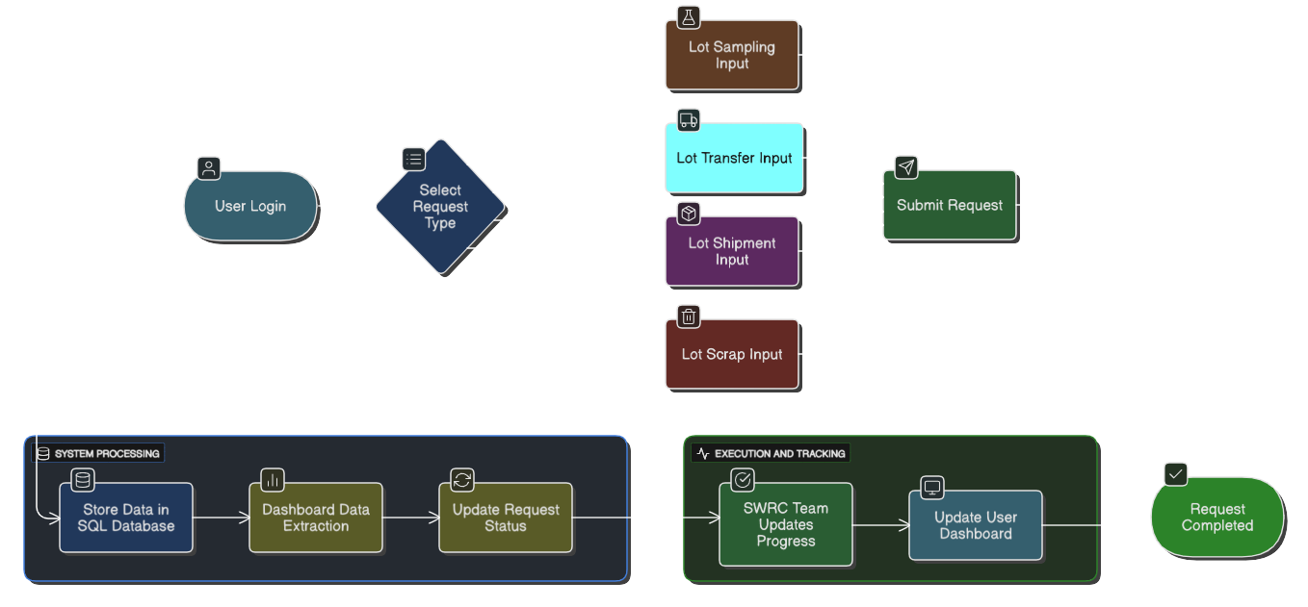
D0
D1
D2
D3
D4
D5
D6
D7
D8
D5: Develop Permanent Corrective Action
Notes:
This flowchart explains how the new SWRC Ticketing System works.
First, the user logs in with their username and selects the request type — either lot sampling, lot transfer, lot shipment, or scrap. Users will then input the required information such as lot ID, QAWR number, lot location, and else..
Once the request form is completed and submitted, all data is stored in a SQL database.
From there, Power BI or Tableau dashboards automatically extract the data and display it in real time.
This provides SWRC with a clear overview of all requests, while allowing users to monitor their task status — whether it is pending, in progress, or completed.
This structured workflow ensures that all requests are properly logged, tracked, and visible to both requestors and SWRC, eliminating the risks of missed emails or delayed actions.

Slide 11
D0
D1
D2
D3
D4
D5
D6
D7
D8
D6: Implement Permanent Corrective Action
WAS
IS
⚠️ Email-based intake
⚠️ Manual tracking in Excel
⚠️ No visibility for requestors or SWRC
⚠️ Prone to errors & delays
✅ Automated intake through web app
✅ Centralized SQL database
✅ Real-time dashboards
✅ Scalable for multi-site
Headcount reduction
⚠️ Before (Manual) | ~4 hours/day x 5 days = 20hrs/week
✅ After (New system) | ~5 hours/week
Savings | (20 hours – 5 hours) / 40 hours/week = 0.4 HC
Time savings
⚠️ Before (Average request logging ) | 30 minutes/requests
✅ After (Average request logging ) | 10 minutes/requests
Savings | (30mins– 10mins) / 30mins * 100 = 66.67%
Notes:
In D6, we implemented the permanent corrective action and compared the old process with the new system.
Previously, the process WAS entirely email-based, with manual tracking in Excel. This meant there was no visibility, the process was prone to errors, and requests were often delayed or missed.
Now the process IS automated. Requests are submitted through a web-based ticketing app, all data is stored in a centralized SQL database, dashboards provide real-time visibility, and email alerts ensure no request is overlooked. The system is also scalable across multiple sites.
From this implementation, we could achieved measurable project gains. We can save around 0.4 headcount from manual tracking, achieved about 66.67% faster request processing, reduced errors by eliminating missed requests, and provided real-time visibility for all stakeholders through dashboards.
This shows how the corrective action not only solved the problem but also delivered efficiency, reliability, and scalability.

Slide 12
D0
D1
D2
D3
D4
D5
D6
D7
D8
D7: Preventing Recurrence
📑 SOP | SOP created for SWRC job requests
🚫 Email disabled (only ticketing system allowed) | Ticketing system mandatory; email intake disabled
👤 Access control / user roles | Access control & roles for accountability
📊 Dashboards | Dashboards monitored weekly
🔔 Alerts & escalation rules | Automated alerts & escalations for overdue requests
♻️ Continuous improvement loop | Quarterly reviews for continuous improvement
Notes:
To prevent recurrence of missed requests and inefficiencies, we implemented strong process controls and governance measures.
A formal Standard Operating Procedure will be created to define the end-to-end workflow for SWRC job requests.
The ticketing system is now mandatory, and email submissions have been disabled to eliminate unstructured intake.
Access control and user roles have been established to ensure accountability for both requestors and executors.
Dashboards in Power BI or Tableau are reviewed weekly, and automated alerts with escalation rules are triggered for overdue requests.
Finally, we built a continuous improvement loop, with quarterly reviews of system performance and user feedback to drive enhancements.
Together, these actions ensure the solution is not only effective now but will also remain scalable, reliable, and aligned with operational needs in the long run

Slide 13
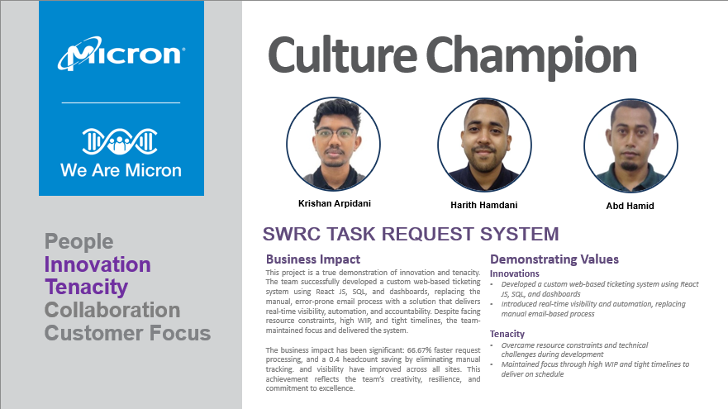
D0
D1
D2
D3
D4
D5
D6
D7
D8
D8: Recognizing the Team
Notes:
Finally, I would like to congratulate my teammates Harith and Abd Hamid for their dedication and perseverance in delivering this project successfully.
I would also like to extend my sincere thanks to our leaders and mentors in MMP GQ OPS for their continuous guidance and support throughout this journey. That is all from us, thank you!

Slide 14
THANK YOU!

Slide 15
SWRC Job Request Submission System
Problem Statement/Background
Scope
The Special Work Request Center (SWRC) is a hub for managing various tasks related to sampling preparation, shipment, logistics, and product inventory. It involves several key activities such as sampling according to a requester's reliability plan, executing shipment requests, collecting and passing sample lots, and managing lot disposition. SWRC is crucial for ensuring that all these tasks are carried out efficiently and effectively, supporting the overall operations. The current job request submission process at SWRC is inefficient and prone to errors due to its reliance on manual intervention and tracking via email. This inefficiency has led to significant issues, such as one case scenario of missed lot shipments to MSB for Thermal Warpage from QAWR121739 and QAWR121740. The root cause of these missed shipments was SWRC's failure to sample and ship the lots on time due to email missed out and high sampling WIP and unable to arrange the priority
Designing and developing a web-based application for job request submissions.
Creating a dashboard for users to track the status of their job requests.
Integrating email notifications to inform users about the status of their requests.
Ensuring the system is scalable and can handle many concurrent users.
Providing training and documentation for end-users and administrators.
Resources/ Stakeholders
Technical Resources:
Development Tools: React JS, PHP, Python, Perl
Servers: For hosting the web application and database
Database Management System: To store and manage job request data.
Email Service: For sending notifications to users.
Proposed Solution
Implement a ticketing system to track all job requests to SWRC. The system will allow users to submit job requests, track their status, and check for status updates.
Objectives & Deliverables
Key Dependencies, Risks, Issues
Develop and deploy a job request tracking system.
Provide training and documentation for end-users and SWRC as executors.
Ensure smooth adoption of the new system.
Dependencies: Availability of IT resources, integration with existing systems, and implementation of email triggering
Risks: Potential resistance to change, technical issues during implementation
Issues: Ensuring data accuracy and timely updates
Pilot Process Area
MMP
Resources Needed
Fan-out Process Area
Training and Documentation: Comprehensive training and documentation for end-users and administrators to ensure smooth adoption of the new system.​
MSB, MTB, MXA, MSI
Notes:
Define unique external factors that require doc standardization exceptions - Geographical, language (English as master doc language), equipment availability
Use Big Rocks for decision/ support escalation

Slide 16
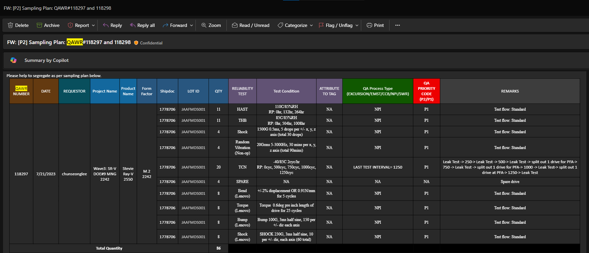
SWRC Job Request Submission System
Objectives: |  | The objective is to develop and deploy a job request tracking system, provide comprehensive training and documentation for end-users and administrators, ensure smooth adoption of the new system, and track and report metrics on job requests.
Collaboration Partners (highlight as needed)
MSB | MMP | MSI | MTB | MXA | - | ATCQ
Executive Summary (accomplishment toward objective)
The Special Work Request Center (SWRC) is essential for managing sample preparation, shipment, logistics, and product inventory tasks. However, the current job request submission process is inefficient and prone to errors due to manual intervention and email tracking. This has led to missed lot shipments to MSB for Thermal Warpage in scenarios QAWR121739 and QAWR121740. To address this, we will develop and deployed a job request tracking system, provided comprehensive training and documentation, ensured smooth adoption of the new system, and implemented metrics tracking and reporting to enhance efficiency and accuracy.
Sponsor | Zainudeen, Vickneswaran
Project Manager | Krishan, Harith
SME/Lead
Phase | 1
Date Updated
Schedule
Budget
Scope
People
 | Status – Actions: Key Milestones and Deliverables | Owner | Date/Status
1 | Discussion and data collection from MSB and MTB | Nicholas, Krishan | Sept 2024 | Completed
2 | Collection and compilation on SWRC Job Requests | Krishan, Harith GQ OPS |  | Not Started
3 | Designing of User & Execution Interface | Krishan |  | Not Started
4 | Testing of User & Execution platform | Krishan, Harith GQ OPS |  | Not Started
5 | Training and briefing to stakeholders | Krishan, Harith |  | Not Started
On Track
At risk
Delayed
Status – Graph/Chart for Measure of Success
Issues – Recommendations (Decisions needed)
Issues Job requests sent via email are prone to being missed due to the high volume of emails. Difficulty in identifying the priority of job requests. Lack of a systematic way to track the status of job requests (open or closed). Recommendations Implement a system to raise job requests via a ticketing system. Prioritize job requests using the FIFO (First In, First Out) rule. Enable tracking of job request status (open or closed) to maintain awareness of current situations. Provide training and documentation to ensure smooth adoption of the new system. Regularly track and report metrics on job requests to improve resource planning
SWRC job request sent through email and prone to be missed-out due to redundant of emails received
SWRC job request will be raised via ticketing using website to be prioritized by FIFO rule and able to observe open or closed request

